Slide 1
Fostering Effective Student Engagement in a First Year University Course by Harmonizing Web-based Resources with Interaction: The WebQuest Approach by Stephen Asunka Ghana Technology University College (GTUC), Accra, Ghana

Slide 2
Outline
Student Engagement
The WebQuest
Objectives of Study
Methodology
Results & Discussion
Implications & Conclusion

Slide 3
Student Engagement

Slide 4
Student Engagement
Engagement simply represents participation in any enterprise by self-investing personal resources, such as time, physical energy, and cognitive power
In Academia, the concept of Student Engagement is a multi-dimensional construct - Academic, Affective, Behavioral & Cognitive

Slide 5
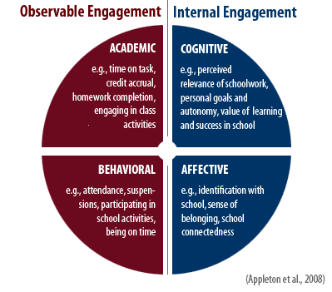
Student Engagement

Slide 6
Student Engagement
Studies have generally established a positive correlation between some or all of the aforementioned aspects of student engagement, and school achievement parameters such as student grades, class attendance, school completion, participation in school and extracurricular activities etc.

Slide 7
Student Engagement
The reverse has also been proven to be the case, i.e. student disengagement or disaffection with school leads to low participation in learning activities, weak grades, cheating in tests, low enthusiasm for school related activities and possibly drop out

Slide 8
Student Engagement
As educators, we need to create learning conditions, processes and activities that will help foster student engagement, and thus increase chances of attaining improved learning outcomes

Slide 9
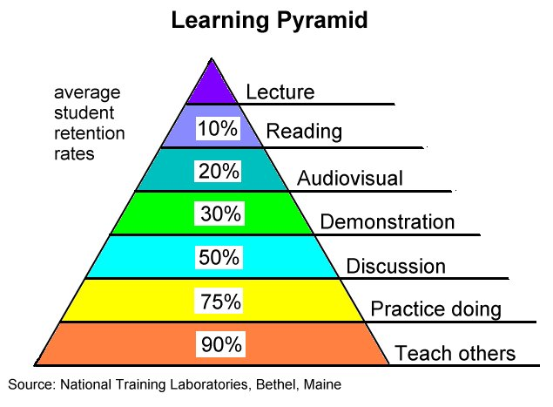
Student Engagement

Slide 10
Student Engagement
Engagement strategies:
Competitive Exams
Field Trips
Lab experiments
Project Based Learning
Game Based Learning
Goal Based Learning
Problem Based Learning
Inquiry Based Learning
Flipped Teaching
Etc.

Slide 11
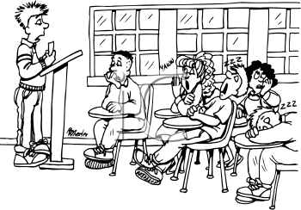
Student Engagement
In higher education, we rarely apply these strategies apart from lecture and exams

Slide 12
Student Engagement
ICTs are now offering us the opportunity to implement most student engagement strategies
One such technology is the WebQuest

Slide 13
What is a WebQuest?

Slide 14
The WebQuest
A web-based inquiry-oriented learning framework that can be used to structure student-centered learning in a particular topic or subject using prescribed computer-based tasks and pre-selected internet resources
Originated by Bernie Dodge

Slide 15
The WebQuest
At its core, the WebQuest is a simple webpage or website that:
outlines a (mostly ill-structured) challenge or problem
provides links to web-based resources as well as information that guides students (usually working in groups) to go through an extended process of inquiry in response to the challenge or problem.

Slide 16
The WebQuest
The essential parts of the WebQuest are organised under six main headings:
Introduction
Task
Process
Resources
Evaluation
Conclusion.

Slide 17
The WebQuest
Learning activities prescribed in a WebQuest emphasize on team work, higher order thinking (analysis, creativity, criticism), knowledge application, social skills and scaffolded learning
It is thus an application of constructivist pedagogy

Slide 18
The WebQuest
The WebQuest approach has been demonstrated to be capable of:
increasing student motivation and performance (Dodge, 2001),
developing students' collaborative and critical thinking skills (Perkins & McKnight, 2005)
enhancing their ability to apply what they have learned to new learning (Pohan & Mathison, 1998).

Slide 19
Research Objective

Slide 20
Research Objective
It is against this backdrop that a study implemented a WebQuest based exercise in an undergraduate course at Ghana Technology University College with the objective of determining:
whether this learning mode can help foster increased student engagement in the learning processes
whether such engagement promotes positive learning outcomes in both the cognitive and affective domains

Slide 21
Methodology

Slide 22
Methodology
Study Context
Level 100 Students in GTUC/Staffordshire University Program
Course Title: Employability, IT & Reasoning Techniques
A major component of this course is "Developing Communication and Critical Thinking Skills," and students are taught the various communication and critical thinking concepts and practices including writing, speaking, listening, analysis, judgement, group communication etc.

Slide 23
Methodology
Process
The WebQuest
http://gtuc.edu.gh/colt/webquest
Local copy

Slide 24
Methodology
Data Sources
Written instructor observations of student behaviours, attitudes, activities etc. during the entire WebQuest learning process
Student perceptions and experiences, obtained from a short questionnaire administered to the students at the end of the learning activities
Student average grades computed from the oral presentation and a written report.

Slide 25
Discussion of Findings

Slide 26
Discussion of Findings
Role Play - Active learning
Increased learner engagement
Increased learner interaction and collaboration

Slide 27
Discussion of Findings
Assessment of Student (Group) Presentation
Learning Process/ Outcome | Achievement Level | Average Score
Content of Presentation | Data quality is established, and quantity is sufficient for coverage. Evidence well supported | 3/4
Presentation | Organization acceptable; no obvious errors but has some information placed inappropriately, contains irrelevant graphics | 2/4
Technology Use | Adequately harnessed technology to organize and deliver content | 3/4
Collaboration | Clear evidence of active collaboration and consensus building | 4/4
Individual Contribution | Each plays their respective roles competently and makes significant contributions | 2/4 (Av.)

Slide 28
Discussion of Findings
Student Scores
Students scored 29/40 for the WebQuest Project
Group Presentation: 14/20
Write-up: 15/20
On the whole, this group of students performed better in the course than their counterparts did in the previous semester

Slide 29
Discussion of Findings
Student Perceptions
Question | Strongly Agree | Agree | Neutral | Disagree | Strongly Disagree
I found this style of learning very useful | 3 | 2
This activity has helped improve my communication skills | 5
I never enjoyed working in the group |  |  |  | 2 | 3
This way of learning should be used in all our other courses | 2 | 2 | 1
I prefer this mode of learning to the lecture mode | 1 | 2 | 2
I can answer any questions on global warming that my classmates might ask me | 5
Write any other comments or reflections you have about this learning experience | Interesting. I watched Inconvenient Truth movie too I enjoy this way of learning bu (sic) We did not have enough time to finish the ppt and also make them look nice

Slide 30
Conclusion

Slide 31
Conclusion
The WebQuest, when designed properly and implemented appropriately in the classroom, can:
motivate students to learn
facilitate the cognitive development of students
contribute to improving students' social and communication skills
enhance students' ability to learn with, and not just about, technology
contribute to students' school achievement and satisfaction with learning activities in general

Slide 32
Lessons

Slide 33
Conclusion
For WebQuest based learning:
Instructor needs to maintain constant oversight of student learning activities, and serve as a guide, not a teacher
Lots of "serendipitous" learning takes place
Instructor motivation and total commitment are equally needed, together with the requisite technical and administrative support

