Slide 1
Strategies for Promoting Active Learner Participation in the Online Component of Blended Courses: An Instructor's Recommendations
Stephen Asunka
Ghana Technology University College
sasunka@gtuc.edu.gh
Presented at:
International Conference on Open, Distance & eLearning (ICODeL-2018)
October 22 -24, Accra, Ghana

Slide 2
Blended (Hybrid) Learning - Definition
The merging of physical and digital learning spaces to complement one another to personalise the learning of all students based on authentic human circumstances and prevailing local technology (Terry Heick, teachthought.com)
Digital component:
0% - Traditional (F-2F)
1 - 29% - Technology facilitated F-2-F learning
30 - 79% - Blended/Hybrid Learning
80+ % - Online Learning
(Allen, Seaman & Garrett, 2007).

Slide 3
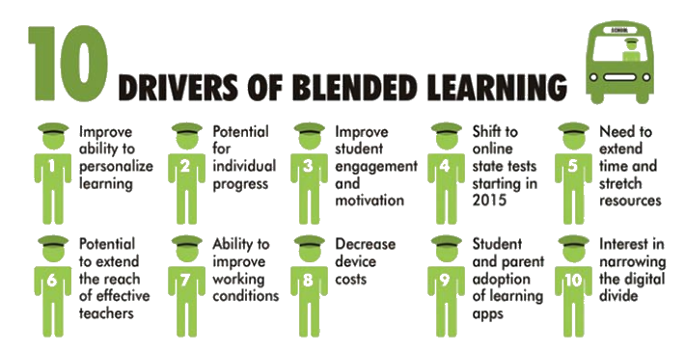
Blended (Hybrid) Learning - Drivers
Source: https://www.teachthought.com/learning/10-drivers-of-blended-learning-in-education/

Slide 4
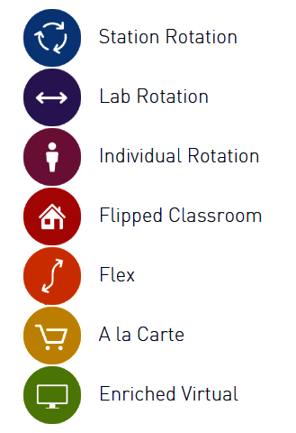
Blended (Hybrid) Learning - Models
Source: https://www.blendedlearning.org/models/

Slide 5
Blended (Hybrid) Learning - Challenges
Technology challenges
Organisational Challenges
Instructional Design Challenges
Looking at how to teach, not just what to teach.
Matching the best delivery medium to the performance objective.
Keeping online offerings interactive rather than just “talking at” participants.
Ensuring participant commitment and follow through with “non-live” elements.
Ensuring all the elements of the blend are coordinated. (Hofmann, 2018)

Slide 6
Blended (Hybrid) Learning - Challenges
Of all these, one of the greatest challenges confronting blended learning instructors is the lack of effective student participation in the online component of blended learning activities (Barria, Scheihing, & Parra, 2014).
Student online participation has positive effects on the learning satisfaction and retention as well as the learning outcomes (Alavi & Dufner, 2005; Morris, Finnegan, & Wu, 2005).

Slide 7
Blended (Hybrid) Learning
Encouraging and sustaining learner participation in the online environment is therefore of utmost importance to online and blended educators and researchers.

Slide 8
Blended (Hybrid) Learning - Participation
What is Student Online Participation?
Frequency of accessing the online environment - downloading content, watching videos etc.
Quantity and quality of contributions by writing
Frequency of reading (and responding to) online messages
Frequency of taking part in online dialogues - discussion forum, online chat etc.
Timeliness of contributions
Frequency of lurking

Slide 9
Blended (Hybrid) Learning - Participation
My Experience
Students tended to procrastinate - contributing only at the last hour
Hardly downloaded course readings, even course syllabus
Hardly watched recommended YouTube videos
Only a few often dominated the discussion forum
Student contributions (in class) often show lack of understanding of the concepts they were supposed to cover online
There was evidence of a lot of lurking
Students rarely asked questions/contacted the instructor online

Slide 10
Blended (Hybrid) Learning - Participation
Interventions that worked / Recommendations
Assessment: All student online participatory activities should be quantified and graded in a transparent manner
Group Discussions & Debates: Anchor these with videos or thought-provoking questions.
Think-Pair-Share: Have students work individually on a problem or reflect on a passage. Students then compare their responses with a partner and synthesize a joint solution to share with the entire class

Slide 11
Blended (Hybrid) Learning - Participation
Interventions that worked / Recommendations
Peer Review: Ask students to submit a one-page response to an assignment question. Give individual submissions to others to review and give feedback
Group Evaluations: Similar to peer review but students work in groups
Brainstorming: Introduce a topic or problem and then ask for student input
Case-Based Learning: Use real-life stories

Slide 12
Blended (Hybrid) Learning - Participation
Interventions that worked / Recommendations
Role Playing: As individuals or groups
Jig-Saw Discussion: Divide a general into smaller, interrelated pieces and assigned to individuals or groups.
Experiential Learning & Sharing: Plan site visits and let students share their experiences online
Social Media Integration: Students create blogs, wikis, twitter feeds etc. Integrate these into the LMS

Slide 13
Blended (Hybrid) Learning - Participation
Interventions that worked / Recommendations
Digital Portfolios: Students should be required to create online digital portfolios
Online Polls: Students vote on issues
Online Assessments: Quizzes etc.

Slide 14
Thank You

