Slide 1
The Relationship between VARK Learning Styles and Learning Outcomes in an Undergraduate Blended Learning Course
Presented by
Stephen Asunka
GTUC
@
13-14 JUNE 2017, ACCRA, GHANA

Slide 2
Outline
Define & Discuss Learning Styles
Learning Style Theories - The VARK Model
The Study
- Process & Findings
- Implications

Slide 3
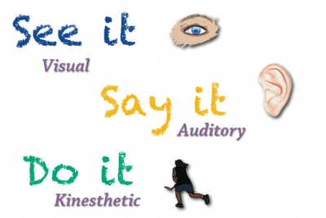
Learning Style
The preferential way in which an individual absorbs, processes, comprehends and retains information

Slide 4
Learning Style
The amount of knowledge that an individual absorbs and retains, is directly related to the degree to which the educational experience is geared toward that individual's learning style, rather than his/her intelligence (Chandler, 2017).

Slide 5
Learning Style
Meshing Hypothesis - students will learn best if teaching approaches are aligned with their individualized learning styles
Teachers should assess the learning styles of their students and adapt their classroom methods to best fit each student's learning style (Pritchard, 2014).
No undisputable evidence that this approach produces better outcomes (Kozhevnikov, et. al., 2014)

Slide 6
Learning Style
Yet, educators continue to hold positive perceptions about the Meshing Hypothesis.
e.g.
Howard-Jones (2014) - over 90% of teachers in five countries (the United Kingdom, the Netherlands, Turkey, Greece, and China) agreed that individuals learn better when they receive information tailored to their preferred learning styles

Slide 7
Learning Style
Several learning style theories, models and inventories are continually being put forth
David Kolb's Learning Style Inventory (LSI)
Peter Honey and Alan Mumford's model
Burke Barbe's Learning modalities
Neil Fleming's VAK/VARK model
Myers-Briggs Type Indicator (MBTI)
Anthony Gregorc's model
Grasha and Riechmann's Cognitive approaches
National Association of Secondary School Principals (NASSP) model

Slide 8
Learning Style
Research works applying these models have still not produced anything conclusive and acceptable
Researchers are hoping that a "new experimental paradigm may eventually emerge and reveal that the Meshing Hypothesis was right all along“ (Willingham et. al., 2015)

Slide 9
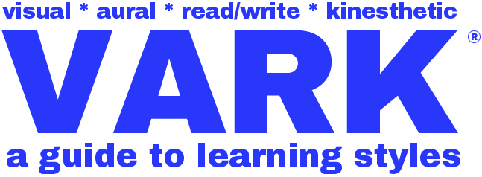
The VARK Model
Neil D. Fleming (1987) developed the VARK inventory in an effort to improve faculty development and to help students become better learners

Slide 10
The VARK Model
Visual learners process information best if they can see it. Graphs, flow charts and pictures are helpful to them.
Auditory learners like to hear the information. Process information best by listening - lectures, recordings etc.
Read/write learners like to see the written words. They like to take notes verbatim and reread these over and over
again.
Kinesthetic learners like to acquire information through experience and practice. They learn best by doing

Slide 11
The VARK Model
The VARK inventory includes a 16-question questionnaire that identifies a person's sensory modality preferences, i.e. learning styles or methods used to process information.
Each question has four possible choices that imply preferences for visual, aural, reading/writing and kinesthetic learning styles
Study participants are required to choose all answers that apply to them

Slide 12
The VARK Model
Attempts have been made to establish relationships between VARK learning style preferences and student performance in university courses.
e.g.
Dobson (2010) - strong kinesthetic learning style had a significant negative relationship with performance in physiology courses
Eudoxie (2011) - no significant relationship between VARK learning style preferences and performance in a soil management science course

Slide 13
The Study
287 level 200 students who took a Java Programming course at GTUC - 1st Semester, 2016-17 academic year
Convenience sample of 70 students
62 completed questionnaire
54 provided their student IDs
Scores of these students retrieved
Analysis - Descriptive Statistics

Slide 14
The Study
Findings
Students were distributed into one of the following categories:
Unimodal - Having only of the V, A, R, or K preferences
Multimodal - Having more than one preference.

Slide 15
The Study
Findings
Multimodal was further classified into
Bimodal - Having two preferences (AK, AR, RK, VA, VK, VR)
Trimodal - Having three preferences (ARK, VAR, VAK, VRK)
Quadrimodal - having all 4 preferences.

Slide 16
The Study
Findings
Majority are multimodal - in agreement with most other studies

Slide 17
The Study
Percentage of Respondents
For unimodal - Kinesthetic predominates
For bimodal - Visual + Kinesthetic predominates
For trimodal - Visual + Auditory + Kinesthetic predominates
No quadrimodal

Slide 18
Style | N | Mean Score (%) | SD | Min | Max
VRK | 3 | 69.09 | 5.34 | 62 | 74
VAR | 2 | 68.12 | 2.08 | 66 | 70
VAK | 6 | 66.06 | 3.25 | 62 | 70
R | 1 | 66.00 | 0.00 | 66 | 66
K | 5 | 65.03 | 5.06 | 57 | 70
VR | 2 | 63.92 | 4.64 | 61 | 67
RK | 3 | 63.67 | 1.57 | 62 | 66
VA | 5 | 63.48 | 4.39 | 57 | 70
AK | 7 | 63.36 | 8.81 | 45 | 74
A | 3 | 61.21 | 7.92 | 55 | 72
AR | 4 | 59.37 | 6.49 | 53 | 70
ARK | 5 | 58.24 | 11.72 | 35 | 67
VK | 8 | 57.48 | 10.29 | 32 | 66

Slide 19
69.01
Learning Style
57.48
Mean score (%)
No Significant d

Slide 20
The Study
Implications
According to VARK inventory, study participants possess a wide diversity in learning styles
No significant difference between preferred learning styles and learning outcomes (scores)
Teachers should combine different educational strategies to meet the varied learning preferences of students.

