Slide 1
Learner Support Services in Blended Learning: The Student Perspective
Asunka, S & Freeman, E.
Ghana Technology University College
Presented at:
2019 ISEIT - International Symposium on E-Learning and Instructional Technologies
May 29 - 31, 2019, Accra, Ghana

Slide 2

Introduction
At GTUC, the Centre for Online Learning & Teaching (COLT) has the singular responsibility of ensuring the successful rollout of blended and online learning at the university college
These learning paradigms involve the extensive use of digital technologies to create suitable, anytime anywhere, learning environments.

Slide 3
Introduction
Students participating in these new (virtual) learning environments require extensive learner support services as they are required to:
  have independent self-directed learning skills
  have the capacity to engage in virtual learning activities
  have access to the Internet and IT resources
  be proficient in the use of learning technologies
  etc.
(McLoughlin & Marshall, 2000)

Slide 4
Introduction
COLT currently provides the requisite learner support services to students who participate in blended learning activities
There is however the need to continuously monitor these services so as to bring constant improvement through innovation and best-practice interventions
This presentation discusses one such monitoring activity - an exposition of students’ perceptions and behaviors with regard to COLT’s learner support services

Slide 5
Blended Learning

Slide 6
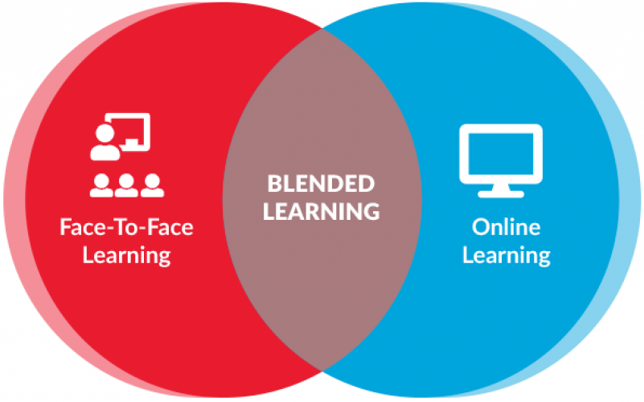
Blended (Hybrid) Learning - Definition
“The merging of physical and digital learning spaces to complement one another, to personalise the learning of all students based on authentic human circumstances and prevailing local technology” (Terry Heick, teachthought.com)
Image source: odysseyware.com

Slide 7
Blended (Hybrid) Learning - Definition
Digital component:
  0% - Traditional (F-2-F)
  1 - 29% - Technology facilitated F-2-F learning
  30 - 79% - Blended/Hybrid Learning
  80+ % - Online Learning
  (Allen, Seaman & Garrett, 2007).

Slide 8
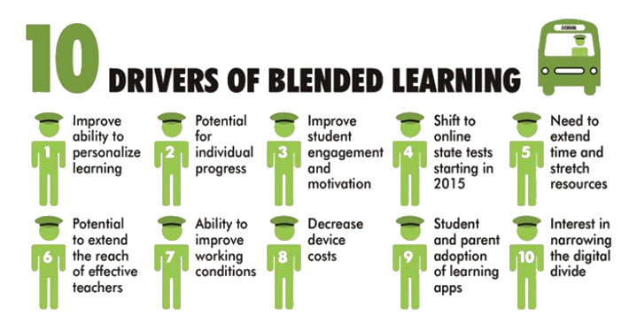
Blended (Hybrid) Learning - Drivers
Source: teachthought.com
Blended learning is now being described as the "new normal' in higher education (Norberg, Dziuban, & Moskal, 2018).

Slide 9
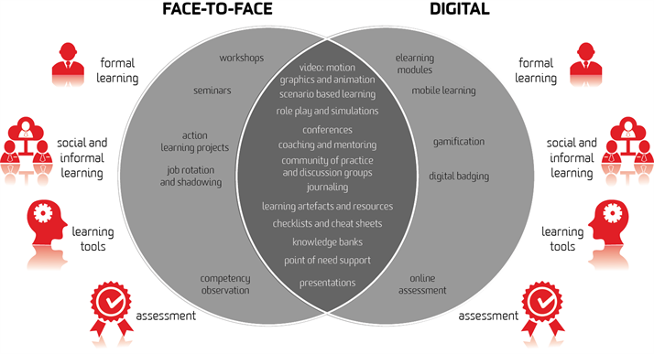
Blended (Hybrid) Learning - Implementation
Source: deakinco.com

Slide 10

Blended (Hybrid) Learning - Outcomes
Several evidence-based studies have concluded that student achievements tend to be higher in blended learning when compared to either fully online or fully face-to-face learning experiences (Siemens et al, 2015)

Slide 11
Blended (Hybrid) Learning - Challenges
Technology challenges
Personal challenges
Institutional Challenges
Instructor and Instructional Design Challenges
One key approach to overcoming most of these challenges and delivering optimal blended learning experiences is to provide timely and effective learner support services

Slide 12
Learner Support in Blended Learning

Slide 13
Learner Support in Blended Learning
What is Learner Support?
In a broad sense:
All activities beyond the production and delivery of course materials that assist learners to progress in their studies

Slide 14

Learner Support in Blended Learning
What is Learner Support?
Involves processes such as:
  Informing
  Advising
  Counseling
  Coaching
  Assessment
  Advocacy
  Feedback to systems

Slide 15
Learner Support Models

Slide 16
Learner Support in Blended Learning
Learner Support Models
The Response to Intervention (RtI) model
Response to intervention is defined as the (non) change in behaviour or performance as a function of an intervention (Gresham 1991)

Slide 17
Learner Support in Blended Learning
Learner Support Models
The Response to Intervention (RtI) model is a multi-tiered approach to providing services and intervention for students, at increasing levels of intensity, based on progress monitoring and data analysis
This model integrates assessment and intervention within a multi-level prevention system to maximise student achievement, promote positive classroom (and online) interactions and reduce behavioural problems (Gresham, 1991).

Slide 18
Blended (Hybrid) Learning - Learner Support
Learner Support Models
RTI Action Network

Slide 19
Research Problem & Objective

Slide 20
Learner Support in Blended Learning
Research Problem
Most contemporary studies on learner support services tend to focus on the online distance learning environment
Assumption is that blended learning students get whatever support they need in the face-to-face sessions…that is flawed

Slide 21
Learner Support in Blended Learning
Research Objective
Contribute to literature
Help inform COLT’s learner support strategies

Slide 22
Learner Support in Blended Learning
Research Questions
How frequently do individual students access COLT’s learner support services?
What support service channels do students frequently use?
What type of support services do students typically access?
What are students’ levels of satisfaction with the learner support services they receive?

Slide 23
Methodology

Slide 24
Learner Support in Blended Learning
Methodology
Quantitative approach
Descriptive survey design
Population - All GTUC students (6000+)
Target population - 1020 (blended learning participants) no sampling
Instrument - Online questionnaire (Microsoft Forms)
Response rate: 244 (24%)
Analysis - Simple descriptive statistics

Slide 25
Learner Support in Blended Learning - Findings
Demographics
Gender Degree
Year of Study Faculty

Slide 26
Learner Support in Blended Learning - Findings
Frequency of requests / access of support services

Slide 27
Learner Support in Blended Learning - Findings
Support service channels typically used

Slide 28
Learner Support in Blended Learning - Findings
Types of support frequently requested / accessed
Password Reset | 108
Account Activation | 76
Course/Module Enrollment | 61
Assignment Submission | 58
Quiz | 50
Learning Resources (Videos, PPT Slides, Course Outline, Text Book etc.) | 42
Similarity Index (Turnitin) | 17
Platform Not Available | 17
Account Doesn't Exist | 6
Other | 9

Slide 29
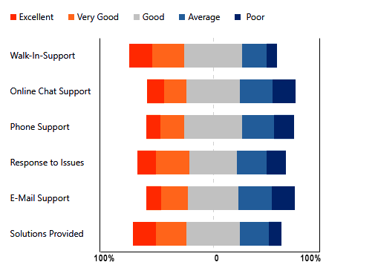
Learner Support in Blended Learning - Findings
Student rating of support services provided

Slide 30
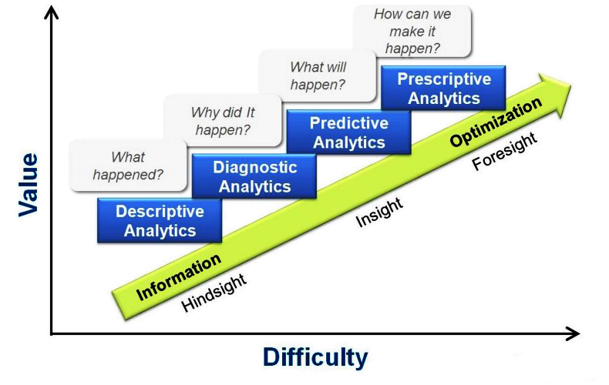
Learner Support in Blended Learning - Conclusion
source: goldstrikedata.com

Slide 31
Thank You

