Slide 1
Online Distance Learning in Higher Education in Sub-Saharan Africa: A Best Practice Conceptual Framework
Stephen Asunka,
Gary Natriello,
Hui Soo Chae
Teachers College, Columbia University

Slide 2
Outline
Introduction
Historical Overview of Higher Ed in SSA
Challenges of Higher Ed in SSA
Coping with the challenges - How far?
The Case for Distance Learning
The State of Online Learning in SSA
A Suggested Framework
Conclusion

Slide 3
Sub-Saharan Africa

Slide 4
Note
The analysis and discussion that follow will be limited to sub-Saharan Africa.
Acknowledging that sub-Saharan Africa is not a homogenous unit, even for present purposes, this limitation of scope should, nevertheless make it easier to make useful generalizations.
Further, it is recognized that the issues to be discussed are not necessarily peculiar to Africa. There will be elements common to most developing countries.

Slide 5
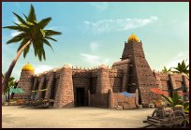
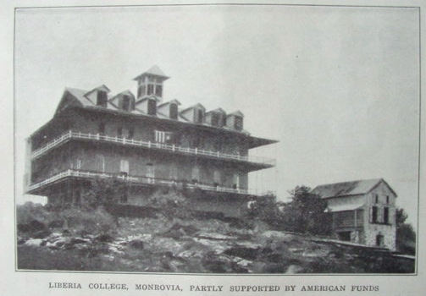
A Historical Overview of Higher Ed in SSA
13th Century AD
Sankore University - Mali
Fourah Bay College - Sierra Leone
Liberia College - Liberia

Slide 6
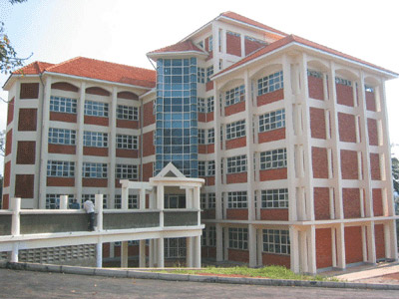
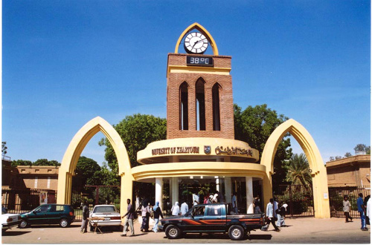
A Historical Overview of Higher Ed in SSA
1930s - 1960s
Universities established in Sudan, Ghana, Zimbabwe, Uganda, Ethiopia, Congo

Slide 7
A Historical Overview of Higher Ed in SSA
1980s
Decline in Quality

Slide 8
Adult Enrolment Ratios
Source: UNESCO Institute for Statistics in EdStats, May 2007

Slide 9
Challenges of Higher Ed in SSA
Massification
Enrolment in African Universities ('000) (Sawyer, 2002)

Slide 10
Challenges of Higher Ed in SSA
Privatization

Slide 11
Challenges of Higher Ed in SSA
Globalization

Slide 12
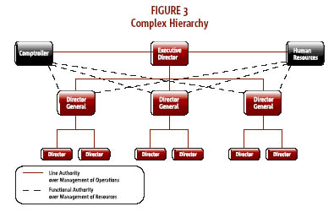
Challenges of Higher Ed in SSA
Governance

Slide 13
Coping with the Challenges - How Far?
Revitalization

Slide 14
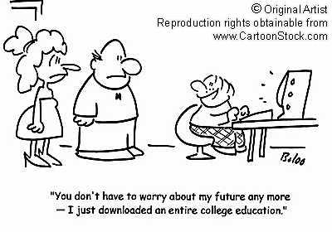
The Case for Online Distance Learning
The Potential of ICTs
Increased access to training
Increased flexibility of access
Increased learner satisfaction
Decreased travel
Reduced time away from work
Quick, easy, inexpensive revisions
Increased consistency of content/delivery
Just in time knowledge
Increased learning retention

Slide 15
The State of Online Distance Learning in SSA
African Virtual University (AVU)
Confederation of Open Learning Institutions in South Africa (COLISA)
UNESCO's open educational resources
Cyber School Africa (CSA)
SchoolNet Africa
Consortium International Francophone de Formation à Distance (CIFFAD)
International Council for Distance Education (ICDE)
Individual University Initiatives

Slide 16
Framework for Online Distance Learning in SSA
1. Analysis
2. Design
3. Development
4. Implementation
5. Evaluation

Slide 17
Framework for Online Distance Learning in SSA
Analysis
- Needs Analysis
- Institutional Analysis
- Learner Analysis
- Delivery Selection
- Content Analysis

Slide 18
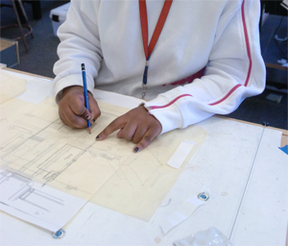
Framework for Online Distance Learning in SSA
Design
- Organize and sequence content
- Write learning objectives
- Write appropriate learning transitions
- Prepare learner assignments
- Prepare assessments etc
⇓
Storyboard

Slide 19
Framework for Online Distance Learning in SSA
Development
The look and feel of the content
Directory structure and navigation of the content
Web content authoring tools

Slide 20
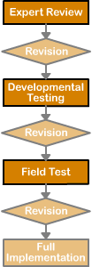
Framework for Online Distance Learning in SSA
Implementation
Formative Evaluation
Expert Review
Developmental Test
Field (Pilot) Test
⇓
Full Implementation

Slide 21
Framework for Online Distance Learning in SSA
Evaluation
Summative Evaluation
Review Goals and Objectives
Obtain data to answer the following:
∗ Did students enjoy the learning processes and activities?
∗ Did they learn anything?
∗ Can they apply what they have learnt in the real world?
∗ Are students satisfied with their learning?
∗ Is Instructor satisfied with the learning process?
- Write a final report

Slide 22
Conclusion
The Challenges facing Higher Ed in SSA are daunting
Distance learning complemented with the appropriate use of ICTs (online learning) can help greatly in addressing these challenges
Recognize that online learning is fundamentally different in its structure, organization and delivery from conventional face-to-face instruction
For online learning to be effective, systematic design and implementation processes informed by policy, research and other educational practices carried out within the African context.

Slide 23
Thank You

