Slide 1
Strategies for Teaching Online Courses within the Sub-Saharan African Context: An Instructor's Recommendations
Stephen Asunka
Hui Soo Chae
Teachers College, Columbia University, New York
Presented at the 2009 Annual Meeting of the American Educational Research Association.
April 12 - 18, 2009. San Diego, CA

Slide 2
Outline
Background & Context
Purpose of the Study
Conduct of the Study
Recommendations based on findings

Slide 3
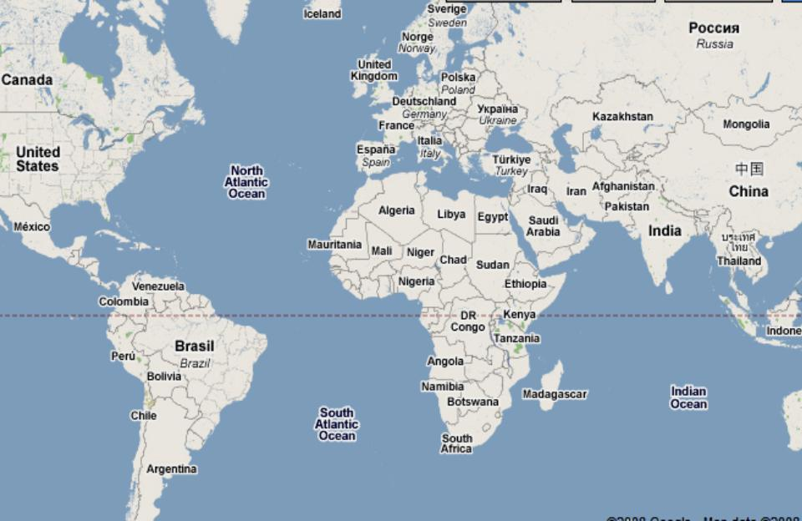
Sub-Saharan Africa
Sub-Saharan Africa

Slide 4
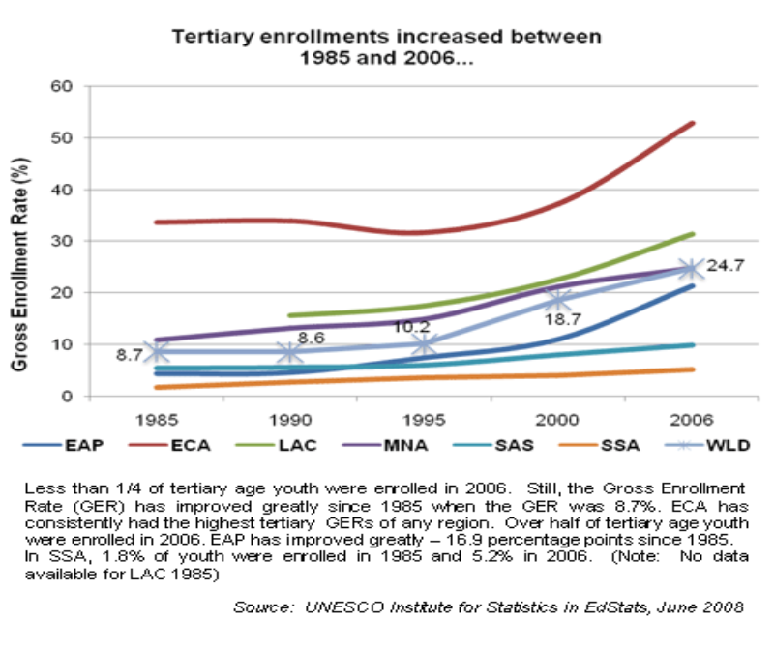
The Higher Education Crisis in SSA
EAP = East Asia & Pacific MNA = Middle East & N. Africa
ECA = Europe & Central Asia SAS = South Asia
LAC = Latin America & Caribbean SSA = Sub-Saharan Africa

Slide 5
The Higher Education Crisis in SSA
Possible Causes:
Inadequate physical infrastructure
Brain drain
Inflexible (outdated) curricula
Dwindling financial resources
Globalization
Politics & Civil wars
HIV/Aids

Slide 6
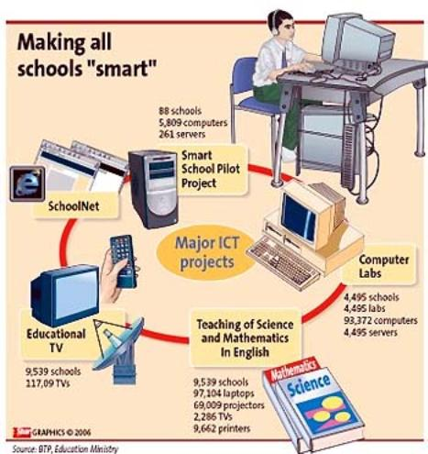
The Higher Education Crisis in SSA
Probable Solution:
Use ICTs in Schools -

Slide 7
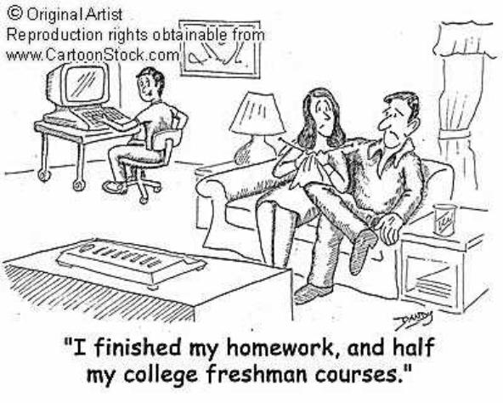
The Higher Education Crisis in SSA
Probable Solution:
Online distance learning -

Slide 8
The Higher Education Crisis in SSA
But…
The digital divide:
3% of people have access to internet in SSA as against a global average of 45%

Slide 9
Objectives of the Study
How do students in SSA perceive Collaborative Online Learning within their context?
What are the main contributory factors to these perceptions

Slide 10
Significance
Understanding students' perceptions will help educators in effectively designing and implementing online courses within the context of limited access to technology

Slide 11
Context of the Study
In 2007, we designed and implemented a fully online collaborative learning course in Educational Technology to two groups of undergraduate students in a private university in Ghana

Slide 12
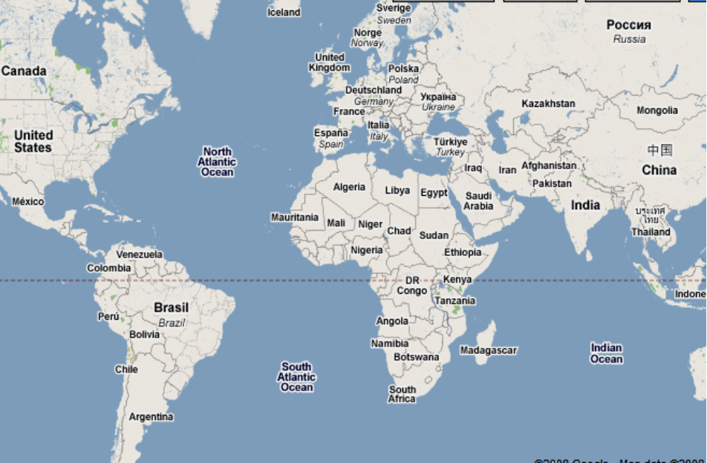
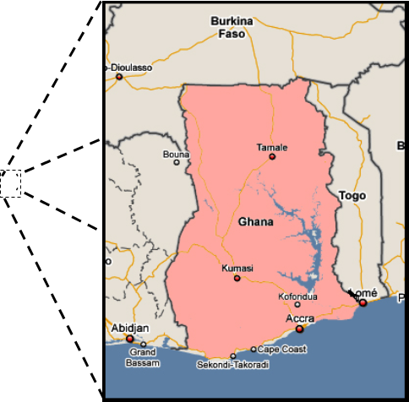
Location of Ghana
Sub-Saharan Africa

Slide 13
Theoretical Framework of Study
TECHNOLOGY
Mode (Media Mix)
Mode (Media Mix)
Time Dispersion
Geographical Dispersion
Software Functionality
Software Interface (Usability)
Reliability
Media Bandwidth
COURSE
Course Type
Course Type
Class size
Subject type
Institutional context
INSTRUCTOR CHARACTERISTICS
Skills
Skills
Effort
Pedagogical Model
STUDENT CHARACTERISTICS
Motivation
Motivation
Ability (GPA)
Skills/Knowledge
Attributes (e.g. age, sex etc.)
Learning Styles
Input
(Moderator
variables)
LEARNING PROCESSES
Amount and type of interaction/activity
Amount and type of interaction/activity
Individual vs. Collaborative learning
Perceived media sufficiency (richness, social presence/community)
Process
(Mediator or Intervening variables)
Output
(Dependent variables)
Access
Faculty Satisfaction
Student Learning
Student Satisfaction
Cost Effectiveness
Input-Process-Output Model for Online Interaction Learning Theory
(Adapted from Benbunan-Fich et al., 2005, p. 24)

Slide 14
Theoretical Framework of Study
TECHNOLOGY
Mode (Media Mix)
Mode (Media Mix)
Time Dispersion
Geographical Dispersion
Software Functionality
Software Interface (Usability)
Reliability
Media Bandwidth
COURSE
Course Type
Course Type
Class size
Subject type
Institutional context
INSTRUCTOR CHARACTERISTICS
Skills
Skills
Effort
Pedagogical Model
STUDENT CHARACTERISTICS
Motivation
Motivation
Ability (GPA)
Skills/Knowledge
Attributes (e.g. age, sex etc.)
Learning Styles
Input
(Moderator
variables)
LEARNING PROCESSES
Amount and type of interaction/activity
Amount and type of interaction/activity
Individual vs. Collaborative learning
Perceived media sufficiency (richness, social presence/community)
Process
(Mediator or Intervening variables)
Output
(Dependent variables)
Access
Faculty Satisfaction
Student Learning
Student Satisfaction
Cost Effectiveness

Slide 15
Methodology
Qualitative Case Study
- Questionnaire
- Email Interviews
- Instructor's observation
- Server log analysis
- Grounded Theory

Slide 16
Conduct of the Study
Course implementation was guided by Graham et al's (2001) adaptation of "Seven Principles for Good Practice in Undergraduate Education,"
Graham, C., Cagiltay, K., Byung-Ro, L., Craner, J., & Duffy, T. M. (2001). Seven principles of effective teaching: A practical lens for evaluating online courses. The Technology Source Archives, March/April. Retrieved July, 13, 2008, from http://technologysource.org/article/seven_principles_of_effective_teaching

Slide 17
Conduct of the Study
Seven Principles of Good Practice
provide clear guidelines for interaction
facilitate meaningful cooperation among students
students should present course projects.
information feedback and acknowledgment feedback.

Slide 18
Conduct of the Study
Seven Principles cont'd
need deadlines
respect diverse talents and ways of learning
challenging tasks, sample cases, and praise for quality work

Slide 19
Conduct of the Study
Students were expected to:
- Read assigned texts and turn in weekly assignments
- Take multiple choice quizzes every 2 weeks
- Contribute to weekly discussions
- Work on group and individual projects
- Complete pre and post-course survey questionnaires

Slide 20
Conduct of the Study
26 Students registered in the first semester
A second iteration of the course was held the subsequent semester, this time involving 25 students.
Some lessons learnt in the first round were implemented, resulting in a much higher completion rate (23 students) and greater student satisfaction

Slide 21
Recommendations Based on Lessons Learnt
Build collaborative learning activities around group competitions
If possible, make all learning activities gradable
Wherever possible, make learning interesting and fun
Offer alternatives

Slide 22
Recommendations based on Lessons learnt
Be flexible with deadlines
Take steps to discourage plagiarism
Involve other means of communicating with students e.g. texting
Treat Technology access and availability as the bottom line

Slide 23
Recommendations based on Lessons learnt
Treat Technology access and availability as the bottom line.
- Provide course documentation as downloadable PDFs
- Make effective use of other (preferably free) third party resources to serve as back-ups
- As much as possible, avoid heavy multimedia applications

Slide 24
Recommendations based on Lessons learnt
Treat Technology access and availability as the bottom line.
- Test course resources including external web resources with a dial-up connection
- For asynchronous discussions, allow students the opportunity to keep contributing to "old" discussion topics

Slide 25
Thank You

