Slide 1
Online Learning in Higher Education in Sub-Saharan Africa: Ghanaian University Students' Experiences and Perceptions
Stephen Asunka
(Ed.D. Candidate)
Program in Computing, Communication and Technology in Education
Department of Mathematics, Science & Technology
Teachers College, Columbia University
Ghanaian University Students' Perceptions of Online Learning - Stephen Asunka (AERA 2008)

Slide 2
Outline
Introduction & Purpose
Brief Literature Review
- Theoretical Perspective & Research Model
- Students' Perceptions of Online Learning
The Present Study
- Study Questions, Setting & Limitations
- Methodology
- Results
- Conclusion & Recommendations
Ghanaian University Students' Perceptions of Online Learning - Stephen Asunka (AERA 2008)

Slide 3
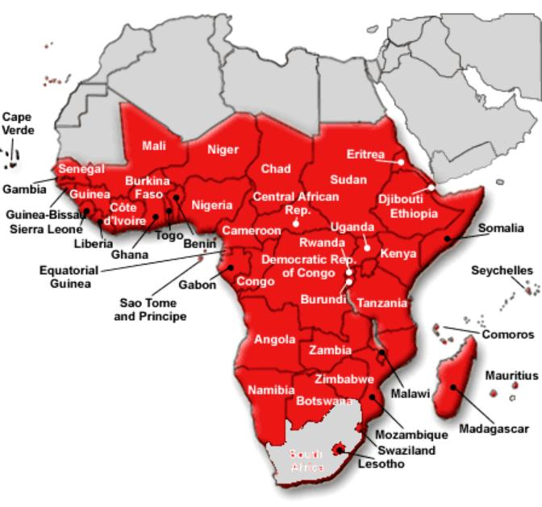
Sub-Saharan Africa
Ghanaian University Students' Perceptions of Online Learning - Stephen Asunka (AERA 2008)

Slide 4
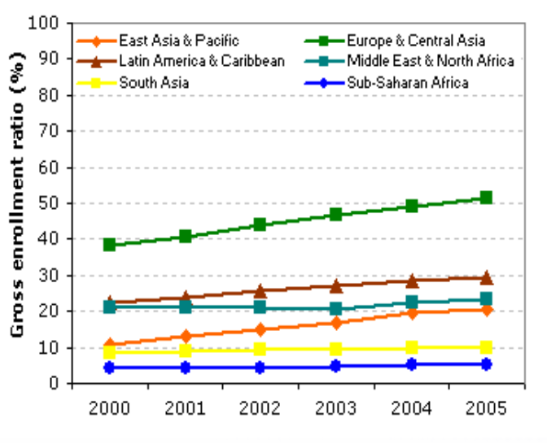
World Adult Enrolment Ratios
Source: UNESCO Institute for Statistics in EdStats, May 2007
Ghanaian University Students' Perceptions of Online Learning - Stephen Asunka (AERA 2008)

Slide 5
Introduction & Purpose
There is an ever increasing demand for higher education in SSA (UNESCO, 2007)
Online (distance) learning can help increase access
But only 3 in 100 people use the internet in SSA as against the global average of 45 in 100 (UNESCO Institute for Statistics, 2007)
Ghanaian University Students' Perceptions of Online Learning - Stephen Asunka (AERA 2008)

Slide 6
Introduction & Purpose
And existing educational structures within SSA are widely perceived to be "too inflexible to accommodate emerging modes of knowledge production or the demands that a greater variety of students will make" (Gibbons, 1998, p 11)
Despite this, institutions are being urged to adopt technology-enabled distance learning initiatives in order to improve access
Ghanaian University Students' Perceptions of Online Learning - Stephen Asunka (AERA 2008)

Slide 7
Introduction & Purpose
It is clear that online learning, as is practiced in the developed parts of the world cannot simply be applied within the SSA context
Empirical studies are therefore needed to understand how best online learning can be implemented within the context of limited facilities, ill-prepared institutions etc.
Ghanaian University Students' Perceptions of Online Learning - Stephen Asunka (AERA 2008)

Slide 8
Introduction & Purpose
As Hiltz, Zhang, and Turoff (2002) concluded: "The evidence is overwhelming that online learning tends to be as effective, or more effective, than traditional modes of course delivery at the university level. There really is no need for more studies to explore this question. What we need is more research that will enable us to make online learning even more effective, especially as new technologies proliferate" (p. 25)
Ghanaian University Students' Perceptions of Online Learning - Stephen Asunka (AERA 2008)

Slide 9
Introduction & Purpose
This study therefore sought to contribute in that direction by studying online learning from the students' perspective, since students' total commitment and participation is crucial for the successful deployment of collaborative online learning initiatives (Petrova & Sinclair, 2005).
Ghanaian University Students' Perceptions of Online Learning - Stephen Asunka (AERA 2008)

Slide 10
Literature Review
Ghanaian University Students' Perceptions of Online Learning - Stephen Asunka (AERA 2008)

Slide 11
Literature Review
Theoretical Perspective & Research Model
Pedagogical, media effects and group interaction theories all contribute in serving as a theoretical basis for collaborative online learning
Most research frameworks for this mode of learning therefore tend to organize research variables in terms of an input-process-output model
Ghanaian University Students' Perceptions of Online Learning - Stephen Asunka (AERA 2008)

Slide 12
Input-Process-Output Model for Online Interaction Learning Theory
(Adapted from Benbunan-Fich et al., 2005, p. 24)
Technology
Mode (Media Mix)
Time Dispersion
Geographical Dispersion
Software Functionality
Software Interface (Usability)
Reliability
Media Bandwidth
Course
Course Type
Class size
Subject type
Institutional context
Instructor Characteristics
Skills
Effort
Pedagogical Model
Student Characteristics
Motivation
Ability (GPA)
Skills/Knowledge
Attributes (e.g. age, sex etc.)
Learning Styles
Input
(Moderator
variables)
Learning Processes
Amount and type of interaction/activity
Individual vs. Collaborative learning
Perceived media sufficiency (richness, social presence/community)
Process
(Mediator or Intervening variables)
Output
(Dependent variables)
Access
Faculty Satisfaction
Student Learning
Student Satisfaction
Cost Effectiveness
Ghanaian University Students' Perceptions of Online Learning - Stephen Asunka (AERA 2008)

Slide 13
Literature Review
The Input-Process-Output model lends itself to quantitative, qualitative and mixed modes of enquiry
Ghanaian University Students' Perceptions of Online Learning - Stephen Asunka (AERA 2008)

Slide 14
Literature Review
What has been reported about students' perceptions of collaborative online learning?
Ghanaian University Students' Perceptions of Online Learning - Stephen Asunka (AERA 2008)

Slide 15
Literature Review
Students' Perceptions of Constructivist Online Learning
both favorable and unfavorable students' perceptions of constructivist online learning have been reported
Ghanaian University Students' Perceptions of Online Learning - Stephen Asunka (AERA 2008)

Slide 16
Literature Review
Students' Perceptions of Constructivist Online Learning
On the positive side:
Convenient and flexible (Leasure, Davis, & Thievon, 2000)
Offers a greater access to learning resources (Sener & Stover, 2000)
Increases student motivation and self-esteem (Kearsley, 1996),
Ghanaian University Students' Perceptions of Online Learning - Stephen Asunka (AERA 2008)

Slide 17
Literature Review
Students' Perceptions of Constructivist Online Learning
On the positive side:
Enhances learner participation and interactivity (Fredericksen et al., 2000; Maeroff, 2004)
Improves the quality of learning (Fjermestad, Hiltz, & Zhang, 2005).
Ghanaian University Students' Perceptions of Online Learning - Stephen Asunka (AERA 2008)

Slide 18
Literature Review
Students' Perceptions of Constructivist Online Learning
On the negative side:
Communication breakdowns and technical difficulties (Hara & Kling, 2003)
Ambiguous instructions (Merisotis & Olsen, 2000),
Ghanaian University Students' Perceptions of Online Learning - Stephen Asunka (AERA 2008)

Slide 19
Literature Review
Students' Perceptions of Constructivist Online Learning
On the negative side:
Unwillingness of other learners to participate in group assignments (Dirkx & Smith, 2004; Maeroff, 2004)
General feeling of 'disconnect' due to the lack of face-to-face interactions (Stodel, Thompson, & MacDonald, 2006).
Ghanaian University Students' Perceptions of Online Learning - Stephen Asunka (AERA 2008)

Slide 20
Literature Review
Students' Perceptions of Constructivist Online Learning
In general, besides technology access, students' perceptions are influenced by:
the design and delivery (especially relating to instructor behavior) of the courses in which they participated
whatever prior knowledge and experiences that students brought to each learning situation (Hiltz & Shea, 2004; Osborn, 2001)
Ghanaian University Students' Perceptions of Online Learning - Stephen Asunka (AERA 2008)

Slide 21
Literature Review
Students' Perceptions of Constructivist Online Learning
In the case of SSA and Ghana
very little empirical studies have been reported as online learning is still in its infancy
Ghanaian University Students' Perceptions of Online Learning - Stephen Asunka (AERA 2008)

Slide 22
Present Study
Ghanaian University Students' Perceptions of Online Learning - Stephen Asunka (AERA 2008)

Slide 23
The Present Study
Study Questions:
What are the expectations and concerns of Ghanaian "traditional" university students who are being made to take a course where all teaching and learning activities will be carried out online, and with a social constructivist approach?
What are student attitudes and behaviors as they participate in their first fully online course for a grade, and what are the trends and patterns of general online use?
Ghanaian University Students' Perceptions of Online Learning - Stephen Asunka (AERA 2008)

Slide 24
The Present Study
Study Questions:
How is the nature of student to faculty interaction in the online environment, and how does this influence student perception of online learning?
How do students' online learning experiences influence their level of perceived learning and satisfaction with the online course?
Ghanaian University Students' Perceptions of Online Learning - Stephen Asunka (AERA 2008)

Slide 25
The Present Study
Study Setting - The Students:
Involved twenty six (26) undergraduate students who were enrolled in an online course - Pedagogical Aspects of ICT - during the second semester of the 2006-7 academic year at the Regent University College of Science and Technology in Ghana
Most were Pre-service teachers offering Computing with Education as a major
Ghanaian University Students' Perceptions of Online Learning - Stephen Asunka (AERA 2008)

Slide 26
The Present Study
Study Setting - The Course:
Course was originally designed as a traditional lecture-based classroom course.
However, to introduce the students to collaborative online learning, the course was reconfigured as an online project-based course, and activities were designed to allow students to work with various technology initiatives, work collaboratively, and also experience what learners in an online course typically experience.
Ghanaian University Students' Perceptions of Online Learning - Stephen Asunka (AERA 2008)

Slide 27
The Present Study
Study Setting - The Course:
Constructivist pedagogy served as the main guide for the design and delivery of the course viz:
- problems must be relevant to students,
- the curriculum should be founded on primary concepts,
- teachers should seek to understand and value students' point of view and adapt the curriculum accordingly,
- authentic assessment should assist the learner rather than to determine a grade (Brooks & Brooks, 1999)
Ghanaian University Students' Perceptions of Online Learning - Stephen Asunka (AERA 2008)

Slide 28
The Present Study
Study Setting - The Course:
However, as the learners were typically "traditional" students who were being introduced to collaborative online learning for the first time, traditional (objectivist) design principles were also applied in most of the models.
Grading was as follows:
Participation in discussions and online surveys - 40 %
Exercises - 30 %
Course project - 30 %
Ghanaian University Students' Perceptions of Online Learning - Stephen Asunka (AERA 2008)

Slide 29
The Present Study
Study Setting - The Course:
The platform for delivery of the course was Claroline (http://www.claroline.net/), an Open-Source web-based Learning Management System, reconfigured and named eCampus by the University
Content was predominantly text-based
The course was designed to be completed in only five learning modules over a 16-week semester.
Ghanaian University Students' Perceptions of Online Learning - Stephen Asunka (AERA 2008)

Slide 30
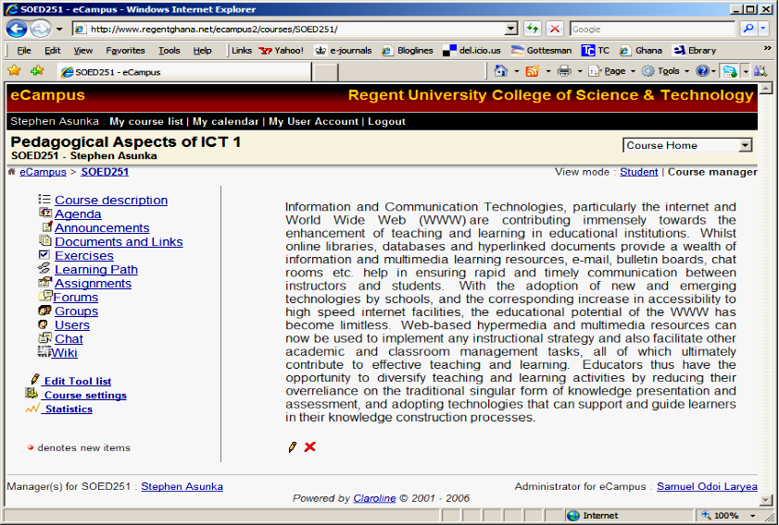
The Present Study
Ghanaian University Students' Perceptions of Online Learning - Stephen Asunka (AERA 2008)

Slide 31
The Present Study
Limitations of Study:
The students involved in the study are already in a technology oriented field and as such findings may not be applicable to entire student populations.
The researcher was the instructor of the course and this might have influenced student responses to questionnaire though efforts were made to ensure anonymity.
Ghanaian University Students' Perceptions of Online Learning - Stephen Asunka (AERA 2008)

Slide 32
The Present Study
Limitations of Study:
The group of students involved in this study had personal physical contacts with each other as they were involved in other classroom based courses. Thus records of students' online collaborative activities probably did not represent all the interactivity that took place pertaining to the course.
Ghanaian University Students' Perceptions of Online Learning - Stephen Asunka (AERA 2008)

Slide 33
The Present Study
Methodology:
Case study
Quantitative and Qualitative Data obtained from:
- Questionnaire (pre- and post-course)
- E-mail and chat interactions with students
- Server logs
- Researcher's personal observation
Techniques such as prolonged engagement, persistent observation, triangulation and reflexive journaling were applied in order to increase the trustworthiness of the data.
Ghanaian University Students' Perceptions of Online Learning - Stephen Asunka (AERA 2008)

Slide 34
The Present Study
Methodology:
Data Analysis
Using the research questions as a guide;
- Quantitative data was analyzed mainly by descriptive statistics with the aid of Microsoft Excel
- Qualitative data, which formed the bulk of the data and information was handled according to the some procedures of grounded theory
- No hypothesis was tested
Ghanaian University Students' Perceptions of Online Learning - Stephen Asunka (AERA 2008)

Slide 35
The Present Study
Results:
Age Distribution of Students (22 respondents)
Age (yrs)
No. (%)
< 20
2 (9 %)
20 - 30
16 (73 %)
> 30
4 (18 %)
Ghanaian University Students' Perceptions of Online Learning - Stephen Asunka (AERA 2008)

Slide 36
The Present Study
Results:
Year of Study
Year of Study
No. (%)
First
13 (59 %)
Second
5 (23 %)
Third
4 (18 %)
Ghanaian University Students' Perceptions of Online Learning - Stephen Asunka (AERA 2008)

Slide 37
The Present Study
Results:
Status
Status of Student
No. (%)
Full Time
18 (82 %)
Part Time
4 (18 %)
Ghanaian University Students' Perceptions of Online Learning - Stephen Asunka (AERA 2008)

Slide 38
The Present Study
Results:
Online Learning Experience
Students' Online Experience
No. (%)
Taken a Fully Online Course
0 (0 %)
Taken a Part Online (Hybrid) Course
6 (27 %)
Never Taken an Online Course
16 (73 %)
Ghanaian University Students' Perceptions of Online Learning - Stephen Asunka (AERA 2008)

Slide 39
The Present Study
Results:
Students' Self-reported Computer Proficiency Levels
Computer Proficiency
No. (%)
Beginner
8 (36 %)
Competent
12 (55 %)
Expert
2 (9 %)
Ghanaian University Students' Perceptions of Online Learning - Stephen Asunka (AERA 2008)

Slide 40
The Present Study
Results:
Students' Access to Technology Outside Campus
Level of Access to Technology
No. (%)
PC only
14 (64 %)
PC & Internet
5 (23 %)
No Access
3 (14 %)
Ghanaian University Students' Perceptions of Online Learning - Stephen Asunka (AERA 2008)

Slide 41
The Present Study
Results:
Students' Opinion on Online vs. F2F Courses
Comparing online with face-to-face learning, online students:
No agreeing
Learn less
7
Learn equally
9
Learn more
6
Don't know
0
Ghanaian University Students' Perceptions of Online Learning - Stephen Asunka (AERA 2008)

Slide 42
The Present Study
Results:
Students' Level of Preparedness for the Course
In My Opinion;
No agreeing
I am very prepared for the course
15
I am somehow prepared for the course
6
I am ill-prepared for the course
0
Don't know
1
Ghanaian University Students' Perceptions of Online Learning - Stephen Asunka (AERA 2008)

Slide 43
The Present Study
Results:
Students' Expectations for the Course
On average, majority of the students indicated their willingness to participate in all online learning activities either often or very often
Some students however expressed reservations and also exhibited some level of anxiety and confusion about the course
Ghanaian University Students' Perceptions of Online Learning - Stephen Asunka (AERA 2008)

Slide 44
The Present Study
Results:
Students' Expectations for the Course
Over 50% of the respondents identified their level of access to the internet as a factor that was most likely going to affect their ability to participate in the course
All students indicated that they expected to learn a lot and also do well (i.e. earn a grade A)
Ghanaian University Students' Perceptions of Online Learning - Stephen Asunka (AERA 2008)

Slide 45
The Present Study
Results:
Students' Online Attitudes and Behaviors
all students had the capability of logging in and accessing the tools and resources of the course.
six students dropped out after about 6 weeks
the remaining students logged in about 55 times each on average, i.e. an average of over 3 sessions a week per student over the 16 week period
Ghanaian University Students' Perceptions of Online Learning - Stephen Asunka (AERA 2008)

Slide 46
The Present Study
Results:
Students' Online Attitudes and Behaviors
80
March ' 07
60
Number of Logins
40
20
0
0
1
2
3
4
5
6
7
8
9
10
11
12
13
14
15
16
17
18
19
20
21
22
23
Hour of day
Ghanaian University Students' Perceptions of Online Learning - Stephen Asunka (AERA 2008)

Slide 47
The Present Study
Results:
Students' Online Attitudes and Behaviors
Though students were accessing the course site regularly, participation in course activities was not as anticipated
Students only downloaded an average of 14 out of 32 documents uploaded by instructor
18 students were recorded as having logged into the discussion forum, but only 11 contributed to discussions
Ghanaian University Students' Perceptions of Online Learning - Stephen Asunka (AERA 2008)

Slide 48
The Present Study
Results:
Students' Online Attitudes and Behaviors
Only 5 students submitted final projects - individually
There was no evidence of collaborative learning activities, though group work was encouraged
Students were a bit more comfortable with the objective exercises - 23 attempted at least one exercise, but 12 completed all 3
Ghanaian University Students' Perceptions of Online Learning - Stephen Asunka (AERA 2008)

Slide 49
The Present Study
Results:
Students' Online Attitudes and Behaviors
By way of e-mail, 15 students sent a total of 65 messages to the instructor, but most dwelt on their personal and logistical issues, requests for extension of deadlines etc.
Also, students contacted the instructor only in moments of desperation
Ghanaian University Students' Perceptions of Online Learning - Stephen Asunka (AERA 2008)

Slide 50
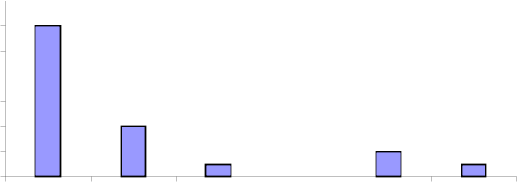
The Present Study
Results:
Learning Outcomes
Final Grades
14
12
12
10
No. of
Students
8
6
4
4
2
2
1
1
0
0
< 40
40-49
50-59
60-69
70-79
> 80
Score
Ghanaian University Students' Perceptions of Online Learning - Stephen Asunka (AERA 2008)

Slide 51
The Present Study
Results:
Learning Outcomes
Student Satisfaction with the Course
Only 33% of respondents indicated that they had benefited from the course, and that the style of learning was very useful
Over 50% felt that they would have learnt more if the course was classroom-based
Ghanaian University Students' Perceptions of Online Learning - Stephen Asunka (AERA 2008)

Slide 52
The Present Study
Results:
Learning Outcomes
Student Satisfaction
In terms of overall satisfaction with the course, another 33% said they were satisfied, with majority (44%) choosing to remain neutral
However, over 60% agreed that the eCampus Learning Management System was helpful, and that given an opportunity, they will take an online course again
Ghanaian University Students' Perceptions of Online Learning - Stephen Asunka (AERA 2008)

Slide 53
The Present Study
Conclusion
Learner characteristics, attitudes and motivation (both intrinsic and extrinsic) have been demonstrated to be very dominant factors that can determine the outcome of an online courses
Ghanaian University Students' Perceptions of Online Learning - Stephen Asunka (AERA 2008)

Slide 54
The Present Study
Conclusion
Students Perceptions of Online Learning
Most Computing in Ed students at Regent University currently see online learning to be complex, more demanding and a significant departure from the traditional "notes copying" activities that they engage in during normal classroom instruction
Ghanaian University Students' Perceptions of Online Learning - Stephen Asunka (AERA 2008)

Slide 55
The Present Study
Conclusion
Students Perceptions of Online Learning
This is in conformity with Hiltz & Goldman (2005), who indicate that "for students who want to do as little work as possible for a course, this mode of learning may be considered a burden rather than an opportunity" (p.13).
Ghanaian University Students' Perceptions of Online Learning - Stephen Asunka (AERA 2008)

Slide 56
The Present Study
Conclusion:
Students Perceptions of Online Learning
Students also placed less emphasis on the online course compared to classroom-based courses - probably because a final exam was not included
Ghanaian University Students' Perceptions of Online Learning - Stephen Asunka (AERA 2008)

Slide 57
The Present Study
Recommendations:
Before introducing online learning in "traditional" universities, prospective students need to be properly oriented and motivated.
Students should also be equipped with basic technology and collaborative learning skills to enable them participate effectively in online learning activities
Ghanaian University Students' Perceptions of Online Learning - Stephen Asunka (AERA 2008)

Slide 58
Thank You
Ghanaian University Students' Perceptions of Online Learning - Stephen Asunka (AERA 2008)

